Slide 1
Multiple features Instructor: Wei Ding
Linear Regression with multiple variables

Slide 2


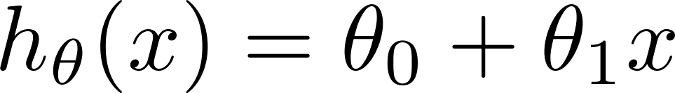
Multiple features (variables).
Size (feet²) | Price ($1000)
2104 | 460
1416 | 232
1534 | 315
852 | 178
… | …

Slide 3
Multiple features (variables).
Size (feet²) | Number of bedrooms | Number of floors | Age of home (years) | Price ($1000)
2104 | 5 | 1 | 45 | 460
1416 | 3 | 2 | 40 | 232
1534 | 3 | 2 | 30 | 315
852 | 2 | 1 | 36 | 178
… | … | … | … | …

Slide 4



Questions: what is x₂⁽³⁾, x₄⁽²⁾, x₁^{(4)?}
Multiple features (variables).
Size (feet²) | Number of bedrooms | Number of floors | Age of home (years) | Price ($1000)
2104 | 5 | 1 | 45 | 460
1416 | 3 | 2 | 40 | 232
1534 | 3 | 2 | 30 | 315
852 | 2 | 1 | 36 | 178
… | … | … | … | …
x₁
x₂
x₃
x₄
y
m=47
training examples
Notation:
= number of features
= input (features) of training example.
= value of feature in training example.
n=4
X⁽²⁾=[1416, 3, 2, 40]
X₃⁽²⁾=2
Notes:
ask several questions about different notation of subscripts and superscripts

Slide 5
Hypothesis:
Previously:
h_{θ}(x)= θ₀+ θ₁x₁+ θ₂x₂+ θ₃x₃+ θ₄x₄
For example,
h_{θ}(x)= 80+ 0.1x₁+ 0.01x₂+ 3x₃-2x₄
Age of the house

Slide 6
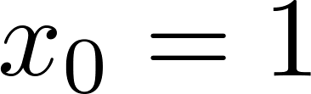
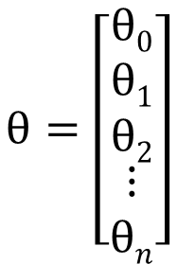
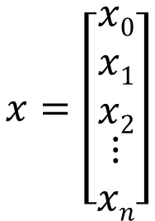
For convenience of notation, define .
X₀^{(i)}=1
$$x=\left[\begin{matrix}\begin{aligned}x0 \\ x1 \\ x2\end{aligned} \\ ⋮ \\ xn\end{matrix}\right]$$
$$θ=\left[\begin{matrix}\begin{aligned}θ0 \\ θ1 \\ θ2\end{aligned} \\ ⋮ \\ θn\end{matrix}\right]$$
h_{θ}(x)= θ₀+ θ₁x₁+ …+ θ_{n}x_{n}
= θ^{T}x
Multivariate linear regression.

Slide 7
Gradient descent for multiple variables
Linear Regression with multiple variables

Slide 8
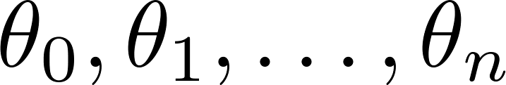
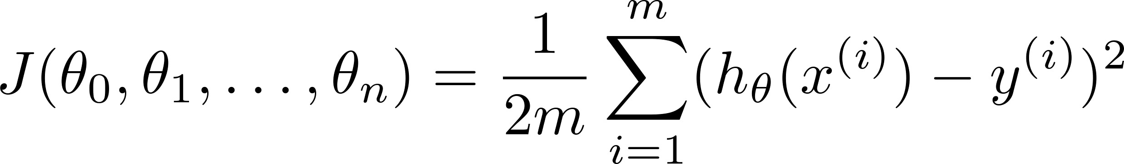

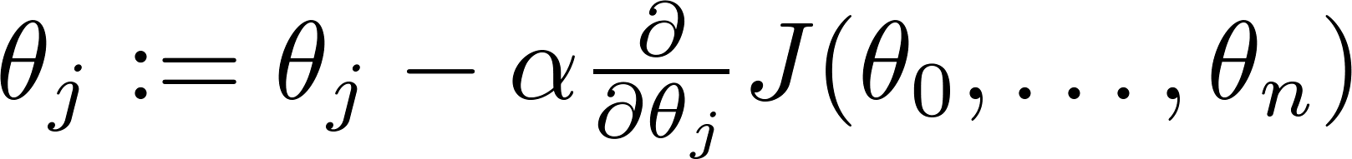

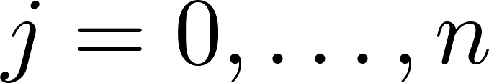
X₀=1
Hypothesis:
Parameters:
Θ → n+1 dimensional vector
Cost function:
J(Θ)
Gradient descent:
Repeat
J(Θ)
(simultaneously update for every )

Slide 9

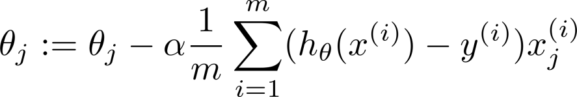
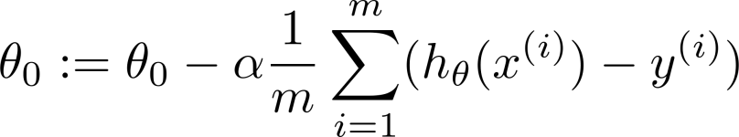



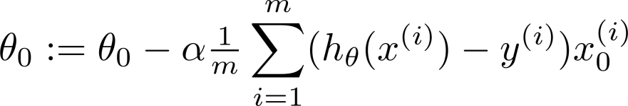
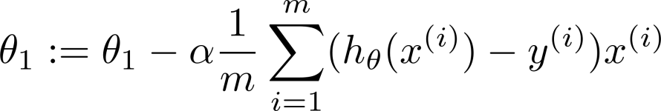
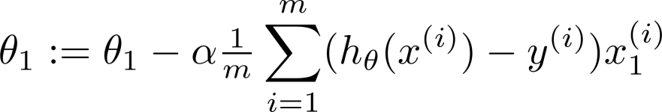

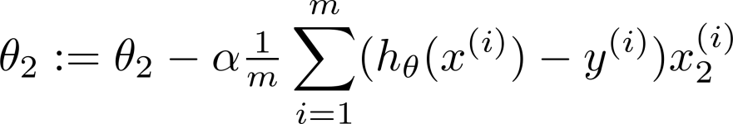
New algorithm :
Gradient Descent
Repeat
Previously (n=1):
Repeat
(simultaneously update for
)
(simultaneously update )

Slide 10
Gradient descent in practice I: Feature Scaling
Linear Regression with multiple variables

Slide 11
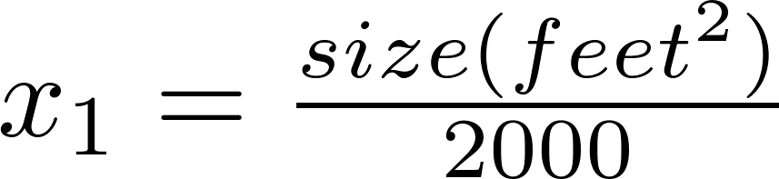


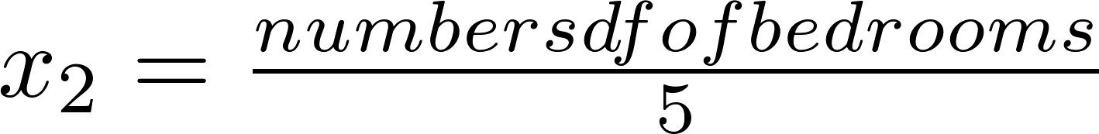



Feature Scaling
Idea: Make sure features are on a similar scale.
0=< x₁ <=1
E.g. = size (0-2000 feet²)
= number of bedrooms (1-5)
size (feet²)
0=< x₂ <=1
number of bedrooms
Screwed elliptical shapes
Converge faster

Slide 12
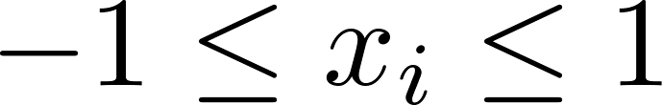
Feature Scaling
Get every feature into approximately a range.
x₀=1
0=< x₁ <= 3
-2=< x₂ <= 0.5
-100=< x₂ <= 100
-0.0001=< x₂ <= 0.0001

Slide 13



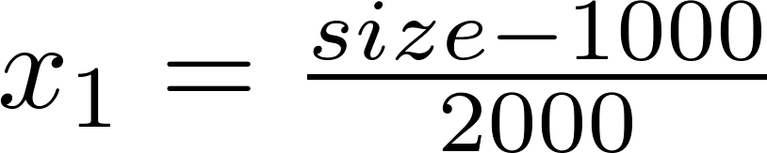
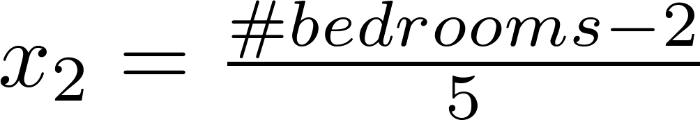
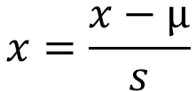
Mean normalization
Replace with to make features have approximately zero mean (Do not apply to ).
E.g.
$$x=\frac{x−µ}{s}$$
µ: average value of x
S: range (max-min) or standard deviation

Slide 14
Gradient descent in practice II: Learning rate
Linear Regression with multiple variables

Slide 15
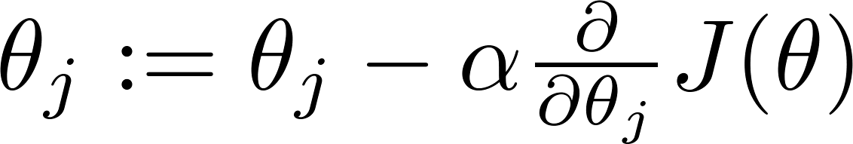

Gradient descent
“Debugging”: How to make sure gradient descent is working correctly.
How to choose learning rate .

Slide 16
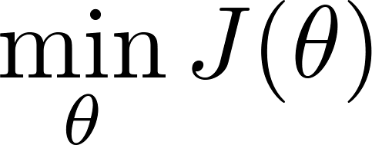
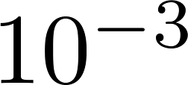
Making sure gradient descent is working correctly.
Example automatic convergence test:
J(θ) should decrease after
each iteration
Declare convergence if decreases by less than in one iteration.
No. of iterations

Slide 17

Making sure gradient descent is working correctly.
Gradient descent not working.
Use smaller .
No. of iterations
No. of iterations
No. of iterations
For sufficiently small , should decrease on every iteration.
But if is too small, gradient descent can be slow to converge.

Slide 18
Summary:
If is too small: slow convergence.
If is too large: may not decrease on every iteration; may not converge.
hyperparameter
To choose , try a range of values:
0.0.003
In machine learning, a hyperparameter is a parameter whose value is set before the learning process begins. By contrast, the values of other parameters are derived via training.

Slide 19
Features and polynomial regression
Linear Regression with multiple variables

Slide 20
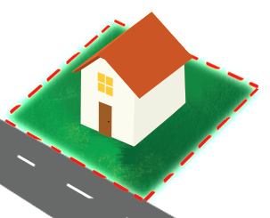
Housing prices prediction
X=frontage * depth (area)

Slide 21
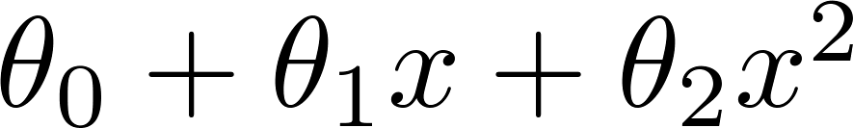
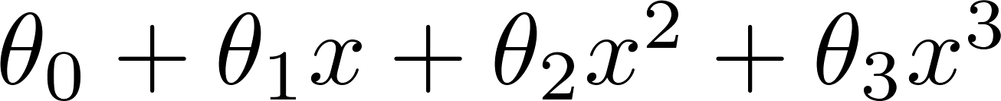
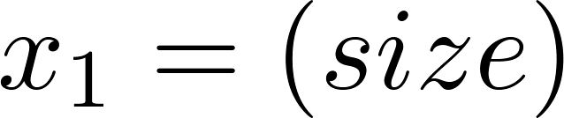
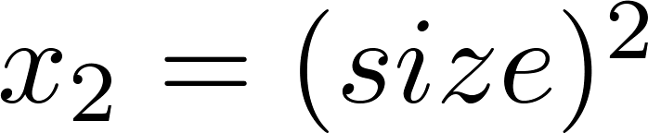
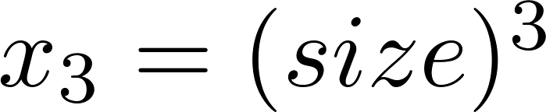
Polynomial regression
Price
(y)
Size (x)

Slide 22
Choice of features
Price
(y)
Size (x)
Feature engineering is the process of using domain knowledge of the data to create features that make machine learning algorithms work. If feature engineering is done correctly, it increases the predictive power of machine learning algorithms by creating features from raw data that help facilitate the machine learning process.

Slide 23
Normal equation
Linear Regression with multiple variables

Slide 24

Gradient Descent
Normal equation: Method to solve for
analytically.

Slide 25

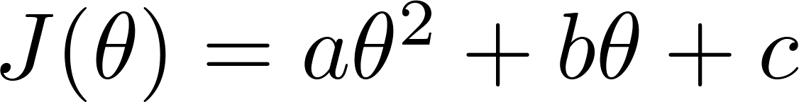

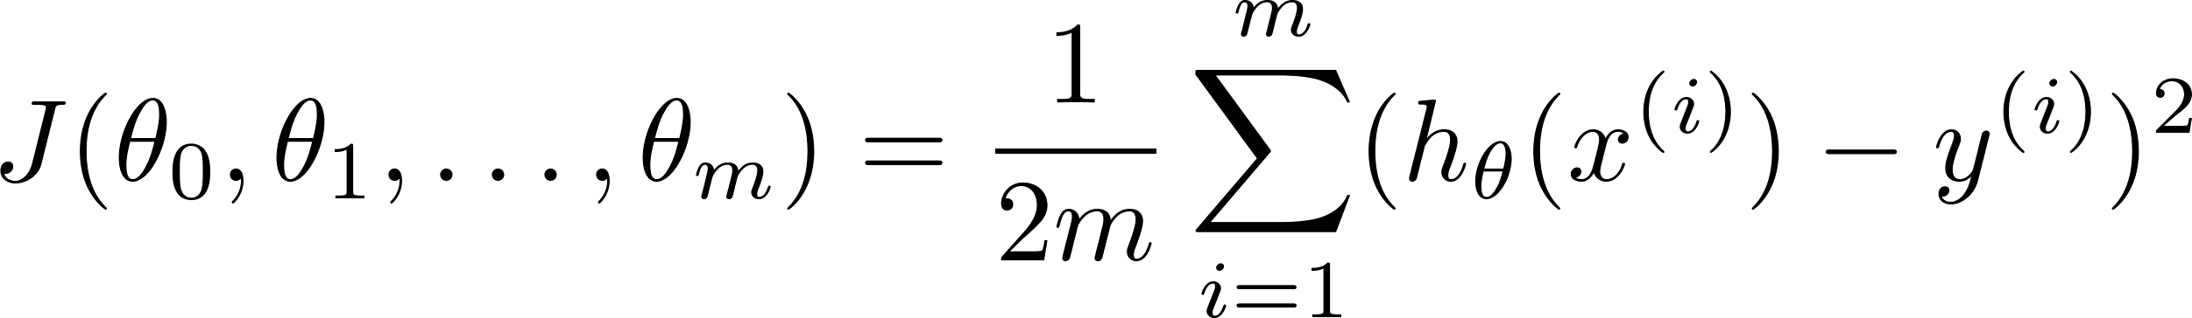
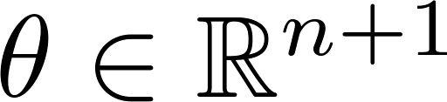
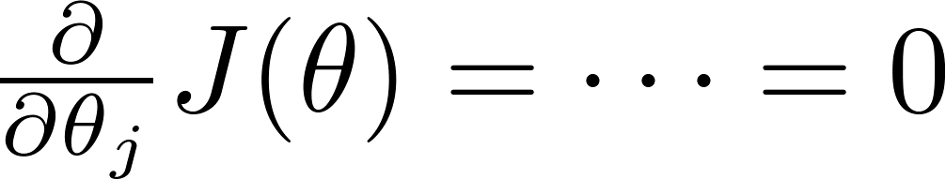

Intuition: If 1D
(for every )
Solve for

Slide 26






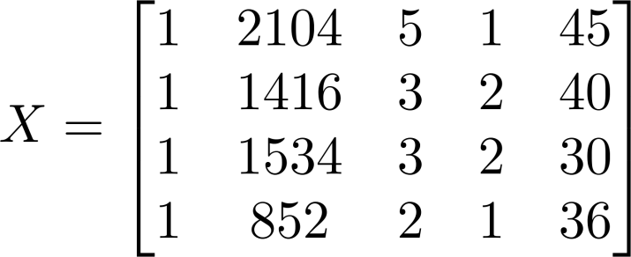
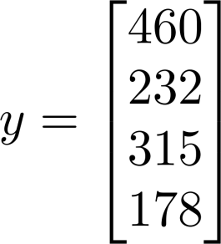
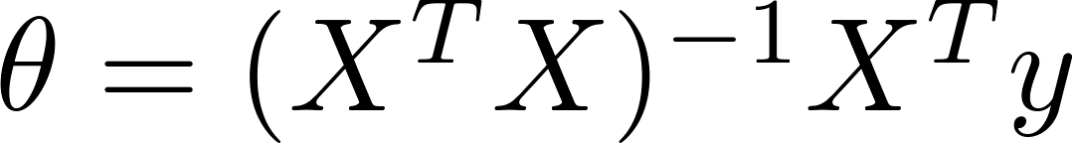
Examples:
 | Size (feet²) | Number of bedrooms | Number of floors | Age of home (years) | Price ($1000)
1 | 2104 | 5 | 1 | 45 | 460
1 | 1416 | 3 | 2 | 40 | 232
1 | 1534 | 3 | 2 | 30 | 315
1 | 852 | 2 | 1 | 36 | 178
Size (feet²) | Number of bedrooms | Number of floors | Age of home (years) | Price ($1000)
2104 | 5 | 1 | 45 | 460
1416 | 3 | 2 | 40 | 232
1534 | 3 | 2 | 30 | 315
852 | 2 | 1 | 36 | 178
Notes:
Pop-up Quiz

Slide 27


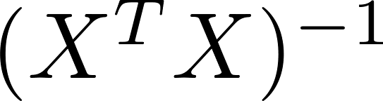
training examples, features.
Gradient Descent
Normal Equation
Need to choose .
Needs many iterations.
No need to choose .
Don’t need to iterate.
Works well even when is large.
Need to compute
Slow if is very large.

